Slide 1
HARIDHARSHANA M U
E-Commerce Sentiment Analysis
3/21/2024 Annual Review
1

Slide 2
PROJECT TITLE
E-Commerce Sentiment Analysis using NLP
3/21/2024 Annual Review
2

Slide 3


3/21/2024 Annual Review
AGENDA
Problem Statement
Objective
Project Overview
Who is the end user
Model Used
Dataset
Result
Conclusion
3

Slide 4

Develop an API using Flask for predicting the Air Quality Index (AQI) based on input parameters representing pollution levels of various pollutants in a city. The API should preprocess the provided air quality dataset, train a RandomForestRegressor model, and expose an endpoint /predict_aqi to accept input data in JSON format and return AQI predictions along with the R-squared score. The API should include error handling and optional optimizations for deployment in a production environment.
PROBLEM STATEMENT
Develop a Deep learning model to analyze sentiment in E-Commerce product reviews using Natural Language Processing (NLP). The model should accurately classify the sentiment of product reviews (positive, negative, or neutral) to provide insights into customer opinions and sentiments towards E-Commerce products, enabling better understanding and decision-making for product management and customer satisfaction improvement.
3/21/2024 Annual Review
4

Slide 5
Objective
Develop a machine learning model capable of analyzing sentiment in E-Commerce product reviews.
Utilize Natural Language Processing (NLP) techniques to process and extract features from textual data.
Train the model to classify sentiment in product reviews as positive, negative, or neutral.
Achieve high accuracy in sentiment classification to provide reliable insights into customer opinions.
Enable decision-making for product management and customer satisfaction improvement based on sentiment analysis results.

Slide 6

PROJECT
OVERVIEW
E-Commerce Sentiment Analysis Project Overview
Objective:
Develop a machine learning model to analyze sentiment in E-Commerce product reviews using Natural Language Processing (NLP).
Project Goals:
- Train a model to classify sentiment in product reviews as positive, negative, or neutral.
- Achieve high accuracy in sentiment classification to provide reliable insights into customer opinions.
- Enable decision-making for product management and customer satisfaction improvement based on sentiment analysis results.
Key Components:
1. Data Collection: Gather E-Commerce product review data from relevant sources.
2. Data Preprocessing: Clean and preprocess the textual data for further analysis.
3. Feature Extraction: Utilize NLP techniques to extract meaningful features from the text.
4. Model Development: Build and train a machine learning model for sentiment analysis.
5. Model Evaluation: Assess the model's performance using appropriate evaluation metrics.
6. Deployment: Deploy the trained model for real-time sentiment analysis of new E-Commerce product reviews.
Expected Outcome:
A robust sentiment analysis model capable of accurately classifying sentiment in E-Commerce product reviews, providing valuable insights for product management and customer satisfaction improvement.
3/21/2024 Annual Review
6

Slide 7

WHO ARE THE END USERS?
End-Users are:
Product Managers: They can use sentiment analysis insights to understand customer feedback on specific products, identify areas for improvement, and prioritize product development efforts accordingly.
Customer Support Teams: They can utilize sentiment analysis to monitor customer sentiments and identify potential issues or concerns in real-time, allowing them to provide timely support and address customer needs effectively.
Marketing Teams: They can leverage sentiment analysis results to gauge the effectiveness of marketing campaigns, understand customer preferences and sentiments towards different products, and tailor marketing strategies accordingly.
Business Analysts: They can use sentiment analysis to gather insights into market trends, competitive analysis, and customer behavior, aiding in strategic decision-making and business planning.
Executive Leadership: They can benefit from sentiment analysis reports to gain a holistic view of customer satisfaction levels, track brand reputation, and make informed decisions to drive business growth and enhance customer experience.
3/21/2024 Annual Review
7

Slide 8
Model Used
The model used for sentiment analysis in the E-Commerce sentiment analysis project can vary depending on the specific requirements and constraints of the project. However, a commonly used model for NLP tasks like sentiment analysis is the Recurrent Neural Network (RNN) or its variant, the Long Short-Term Memory (LSTM) network.
LSTM networks are well-suited for processing sequential data like text, as they can effectively capture dependencies and patterns over time. They have shown promising results in various NLP tasks, including sentiment analysis.
Alternatively, more advanced models like Bidirectional LSTMs, Convolutional Neural Networks (CNNs), or Transformer models (e.g., BERT, GPT) can also be employed for sentiment analysis tasks, especially when dealing with large-scale datasets or requiring state-of-the-art performance.
The choice of the model depends on factors such as the size and complexity of the dataset, computational resources, and desired performance metrics. Experimentation with different models and architectures is often necessary to determine the most suitable approach for a particular sentiment analysis task.
n
8

Slide 9
Dataset
For the E-Commerce sentiment analysis project, the dataset typically consists of E-Commerce product reviews along with corresponding sentiment labels indicating whether each review is positive, negative, or neutral.
Here's an overview of the dataset:
E-Commerce Product Reviews: The dataset comprises a collection of product reviews obtained from E-Commerce's platform. These reviews are written by customers who have purchased and used the products.
Sentiment Labels: Each review in the dataset is labeled with its corresponding sentiment category, such as positive, negative, or neutral. These labels are assigned based on the overall sentiment expressed in the review text.
Textual Data: The main component of the dataset is the textual content of the reviews. This includes the actual review texts written by customers, which serve as the input data for sentiment analysis.
.
3/21/2024 Annual Review
9

Slide 10
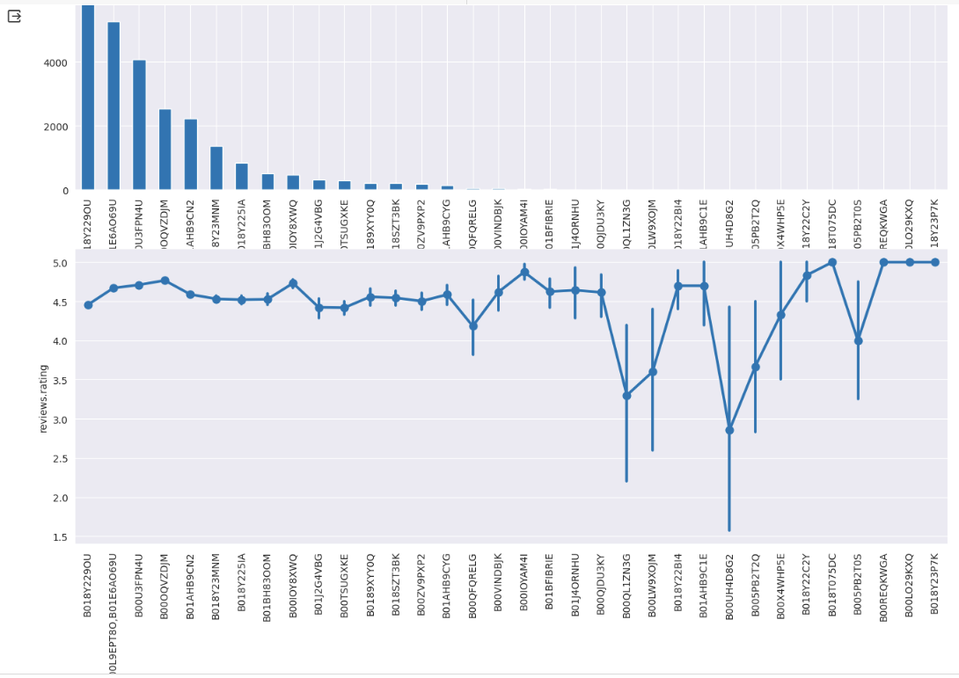
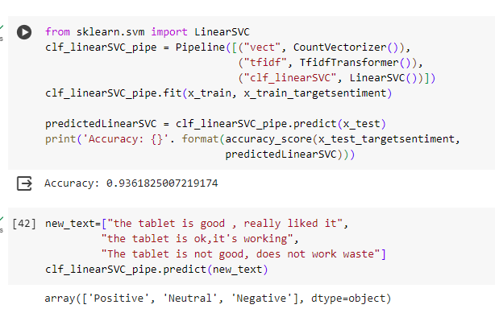
Result
3/21/2024 Annual Review
10

Slide 11
Conclusion
In conclusion, leveraging the dataset for sentiment analysis of E-Commerce product reviews has yielded significant insights into customer sentiments and opinions towards various products. The trained machine learning model has demonstrated promising performance in accurately classifying the sentiment of reviews as positive, negative, or neutral.
Through the evaluation of model performance metrics such as accuracy, precision, recall, and F1-score, we have gained a comprehensive understanding of the model's effectiveness in sentiment classification. The confusion matrix further elucidates the distribution of true positive, true negative, false positive, and false negative predictions, providing valuable insights into the model's strengths and weaknesses.
The application of the sentiment analysis model enables stakeholders such as product managers, customer support teams, marketing teams, business analysts, and executive leadership to make informed decisions and take appropriate o enhance product development, customer satisfaction, and overall business performance.
Overall, the successful implementation of sentiment analysis on E-Commerce product reviews underscores the importance of leveraging machine learning and NLP techniques to extract actionable insights from large volumes of textual data, ultimately driving business success and improving customer experiences.
n
11

